Slide 1
CamWord
An Android Application

Slide 2
Application Developed By :
Zoeb Chhatriwala
Kishan Patel
Hardik Patel

Slide 3
Guided By :
Mrs. Riddhi Patel

Slide 4
About CamWord :
CamWord is an android based application that uses character recognition or voice recognition to identify a word and then translate or define on user request. This application can be used to identify a word in real time from a document through camera or get it identified through voice interactions.

Slide 5
Download CamWord :
You can download CamWord application from
https://camword.cf

Slide 6

Home UI :
There are four button here
OCR
Voice Recognition
Spell Checker
Settings

Slide 7
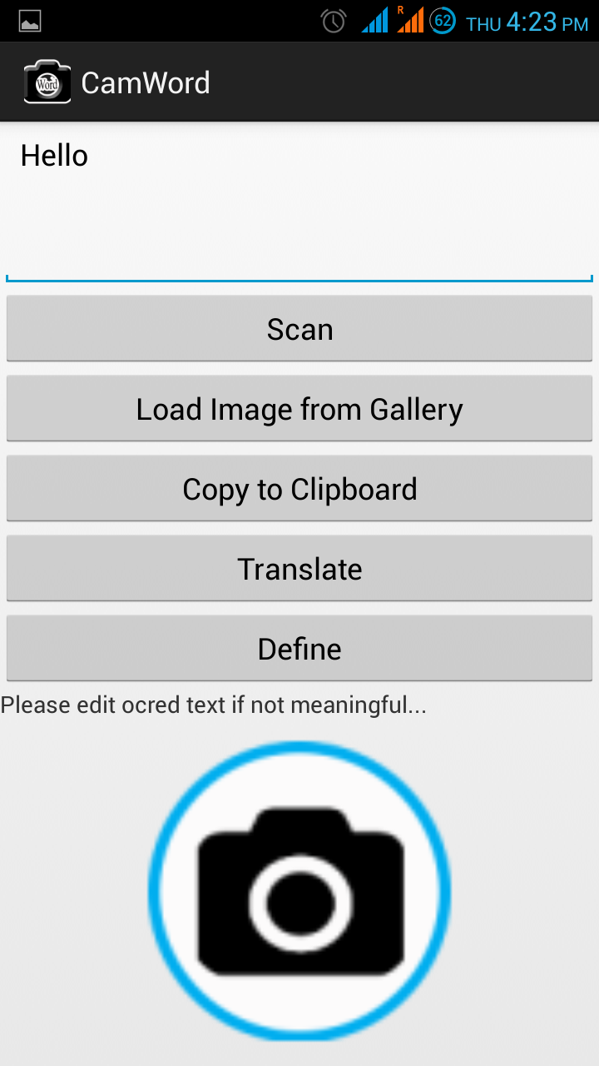
1. OCR
Scan button starts camera so user can take picture of document he/she wants to scan. User can also load image fro his/her gallery.
Output is shown in the text box, Translate and define button do as its name suggests.

Slide 8
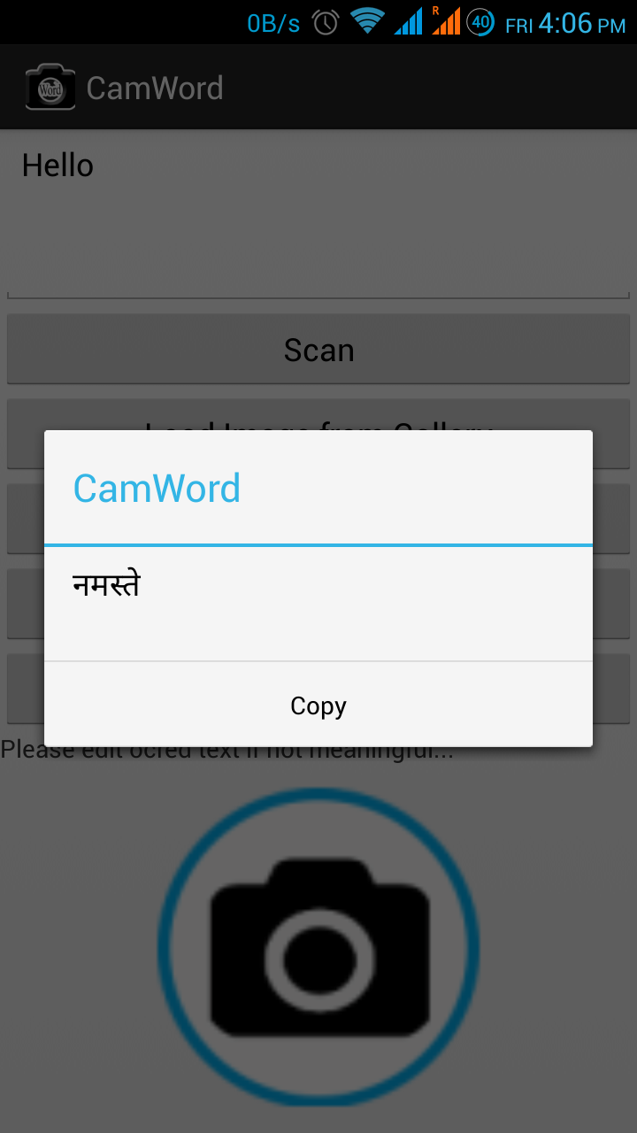
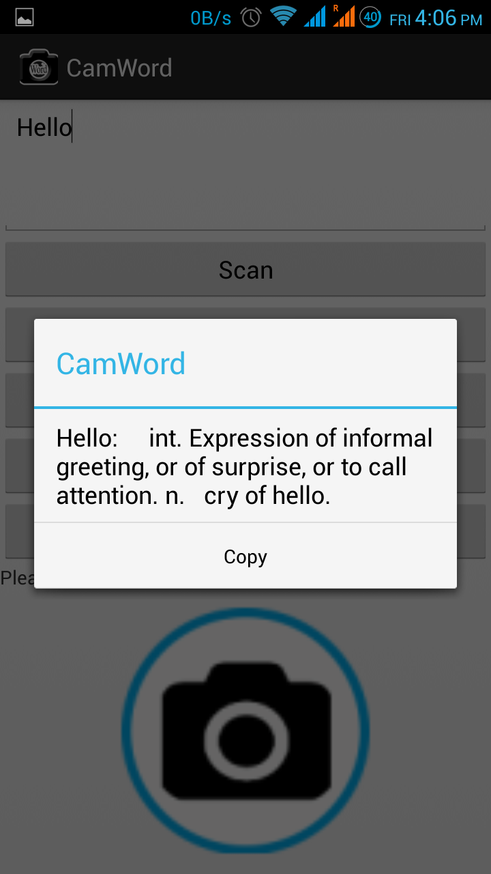
Output for word “Hello”.
Output comes in an message-box with copy button that allows user to copy the output.

Slide 9
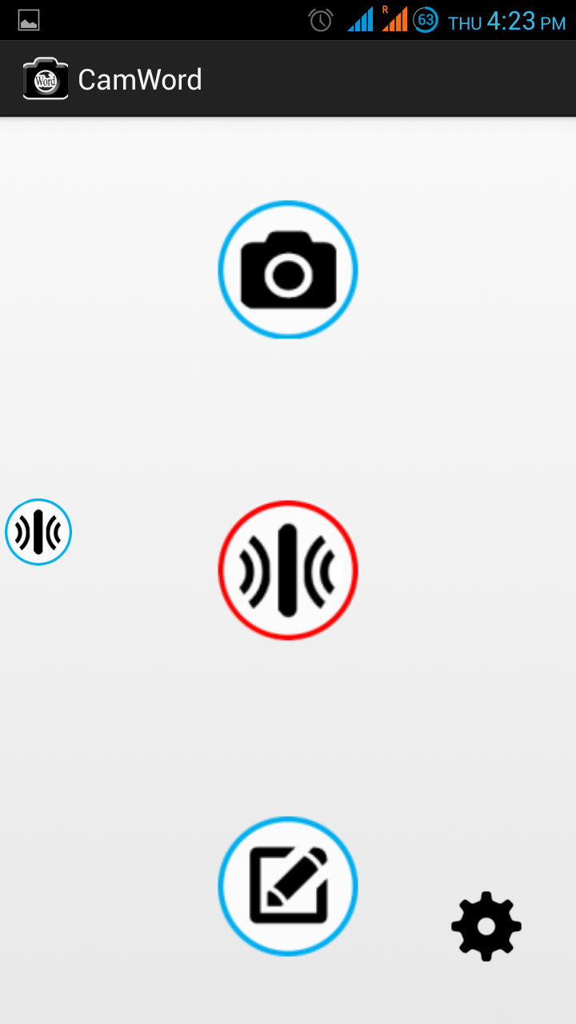
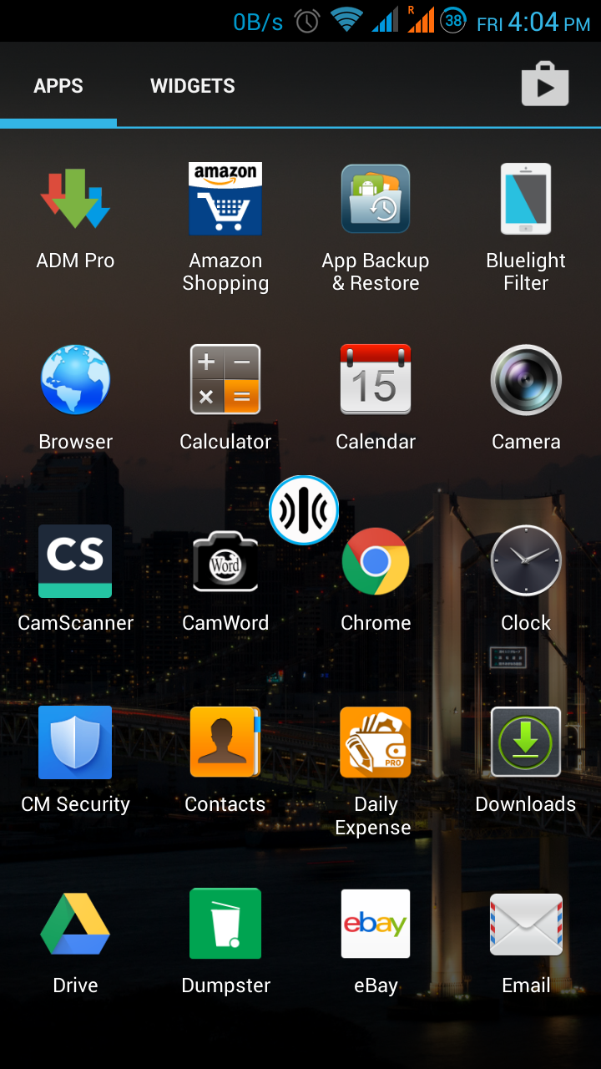
2. Voice Recognition
The floating widget floats as an overlay on android launcher. It can be dragged to any place on the screen.

Slide 10
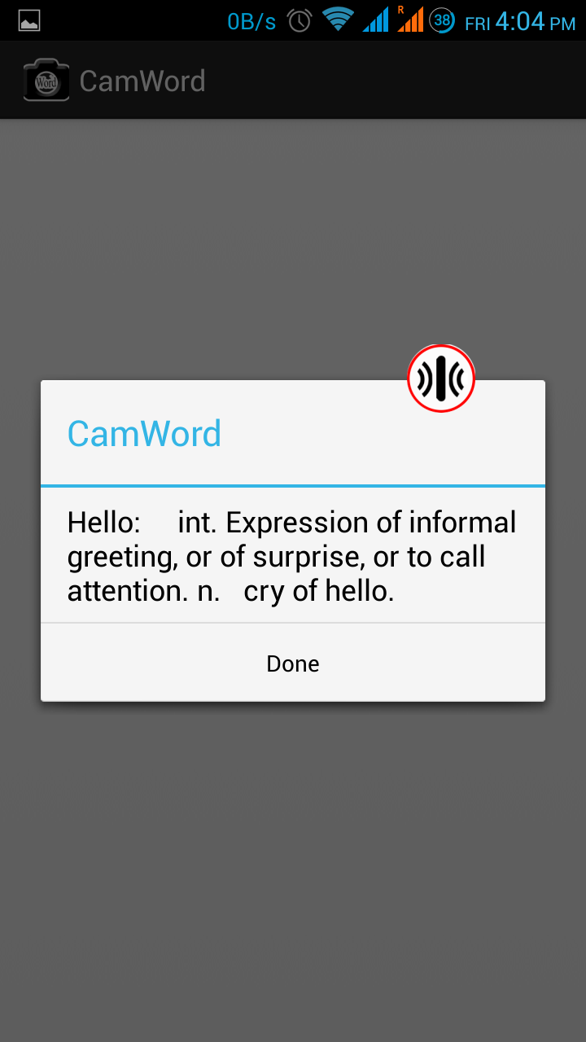
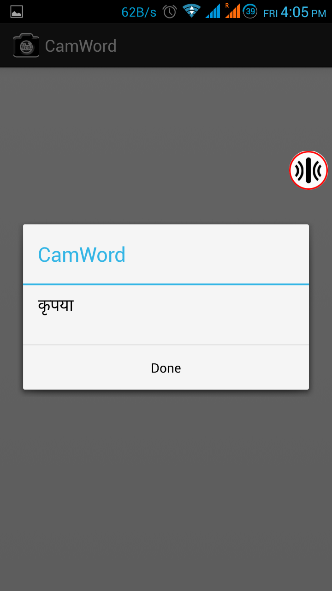
By clicking the floating widget user activates the voice recognition service which will recognize user voice for word.
This word will either be defined or get translated according to user settings.

Slide 11
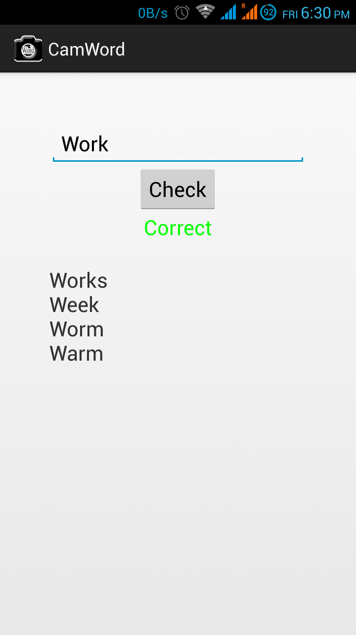
3. Spell Checker
Spell checker checks word spelling and also give suggestions.
User can enter word in spell checker text box to verify whether he/she is correct.

Slide 12
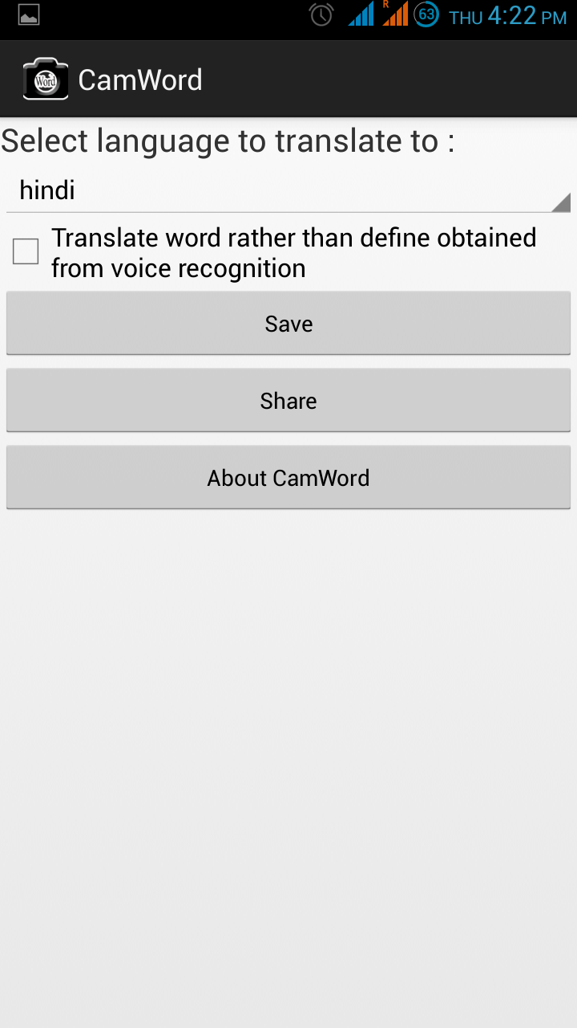
4. Settings
Settings allows user to change his/hers preferences like :
Changing translating language.
Deciding whether he/she want to translate word rather than get its meaning from the voice recognition module.
User can also know about developers and spread the word about CamWord among friends.

Slide 13
Thanks for your precious time…

